Slide 1
Brooding and Broiler production

Slide 2
Include incubation chicks (industrial incubation) from the age of one day or after the exit of chicks from hatcheries to become old (8) week called Pullets and Chicken production well is one of the main factors for the production of eggs chicken rearing chicks need the following factors
Heat*
Ventilation*
Adequate space*
Disease prevention*
Nutrition*
These factors under the control of the human

Slide 3
*Heat *Ventilation
*Adequate space
*Disease prevention
* Nutrition
These factors under the control of the human

Slide 4
*Chicks remain in their house until the age of(8)
weeks and then move to another house until age(18) week that approaching the age of production and then move on to the house of chicken eggs

Slide 5
The needs of the incubation period of the chicks
1-Heat
Chicks need heat for heating purposes *
*Newly hatched chicks need to a temperature estimated at 35 c and should be available under the heat source and the degree 25-30c outside the incubator . *Reduce the temperature under the incubator (2) C per week for a period of (4) weeks, where chicks grow and need the same temperature .
*Incubator the mean source of heating, its works on gas or electricity and the other on the oil, the most common are gas incubators

Slide 6
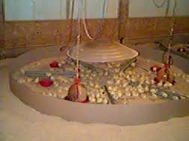
Gas incubator

Slide 7
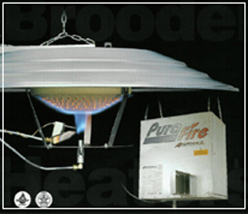
Gas incubator

Slide 8
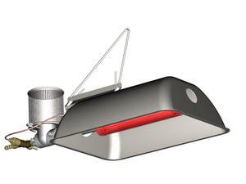
electricity incubator

Slide 9
2-Good ventilation
The ventilation and air movement inside the chicks houses of the important things where you need chicks halls to the air constantly changing and this is achieved through the use of air dischargers to withdraw from the point of views of the hall and make way for the new air to enter the other hand.

Slide 10
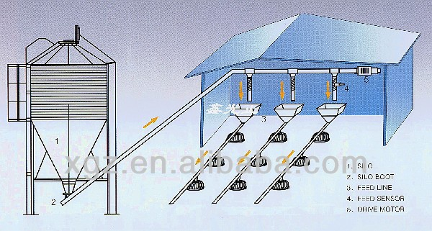

Slide 11
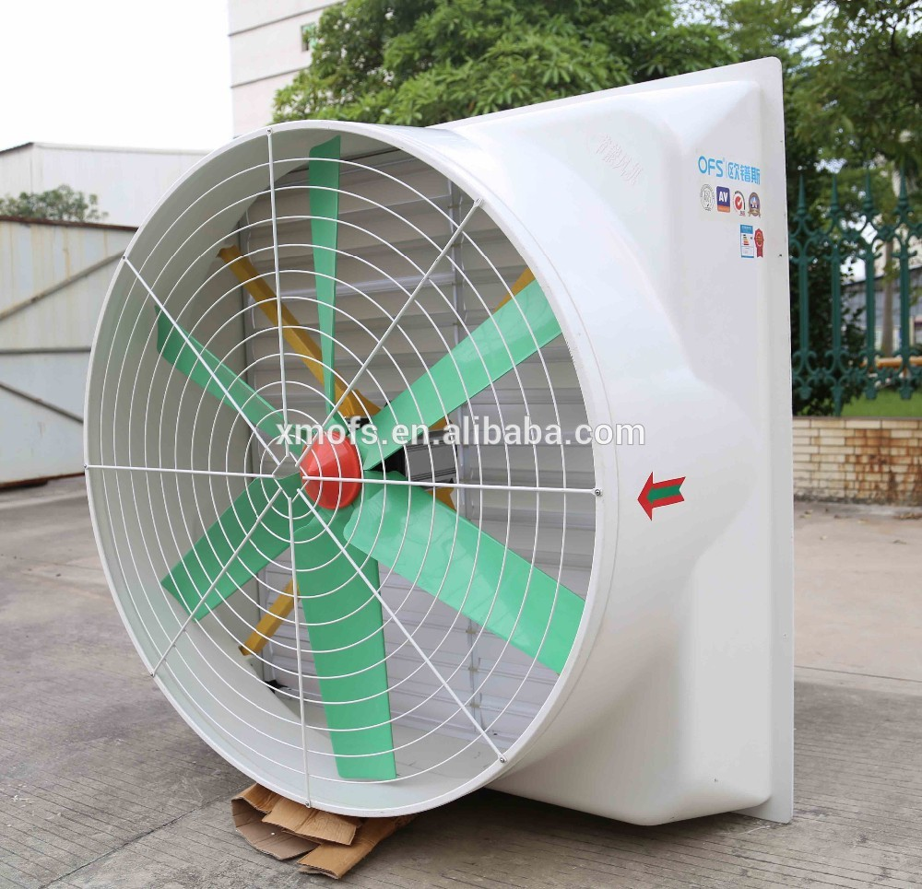
Air master van

Slide 12
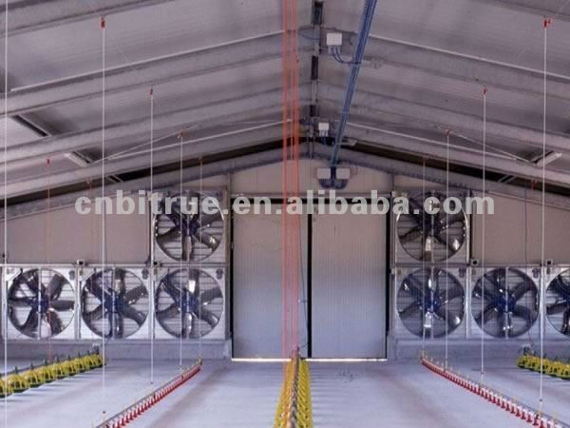

Slide 13
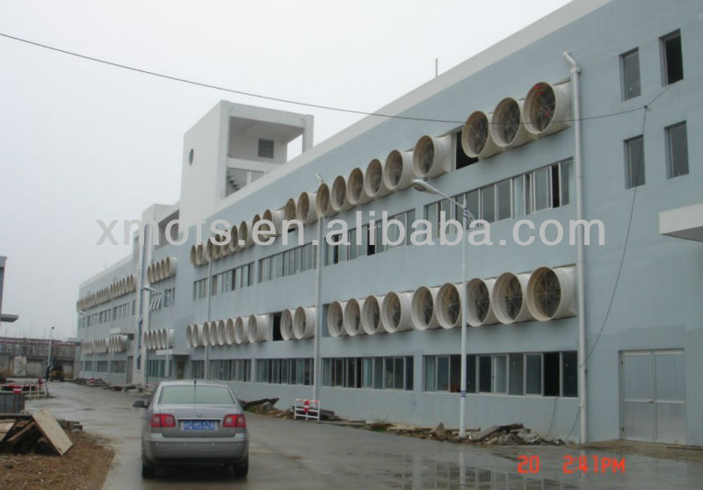
Channel ventilation

Slide 14
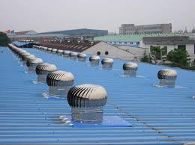

Slide 15
Benefits ventilation
*- Get rid of the old air which may be full of b (co2) where a gallon of gas used by the incubators consumes about (900) cubic feet of oxygen .
Get rid of excess heat.*
Get rid of the dust.*
*Get rid from the moisture in the hall of chicken.

Slide 16
*Get rid of the gases and odors such as ammonia gas produced from the decomposition of uric acid into urea and ammonia that ammonia can be harmful and fumbling
through smell, according to the following concentration
If the concentration limits (15-20) ppm can smell it -1
2-If concentration (40-50) ppm lead to tears of eye or blind eye ammonia for birds
If concentration (50-70) ppm cause respiratory disease of birds-3
4-And ammonia can be checked by means of revealing private papers call (Impregnated paper) gives the colors from orange to red

Slide 17
sources of moisture
1-outside air 15%
feed and water 10%-2
3-Animal itself by breathing and the amount of waste 75% .-
Humidity must not exceed about 40-50% in bedroom.

Slide 18
Need to mangers and utensils
3-Need to mangers and utensils
Must provide sufficient numbers of sources of water and food for the chicks until we get rid of cannibalism and predation between chicks
A-The mangers
a-Allocates (2,5) cm of the length of the manger during the first three weeks
b-Allocates (5)cm of the length of the manger during the second three weeks.
c-Allocates (7,5)cm of the length of the manger after (6)weeks, incase of egg breeds and (10) cm for meat breeds

Slide 19
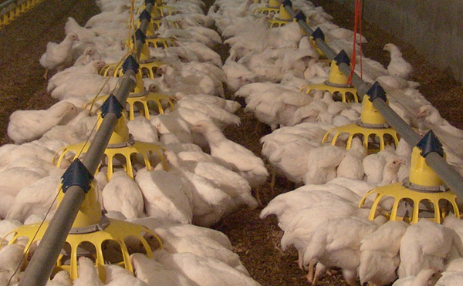
mangers

Slide 20
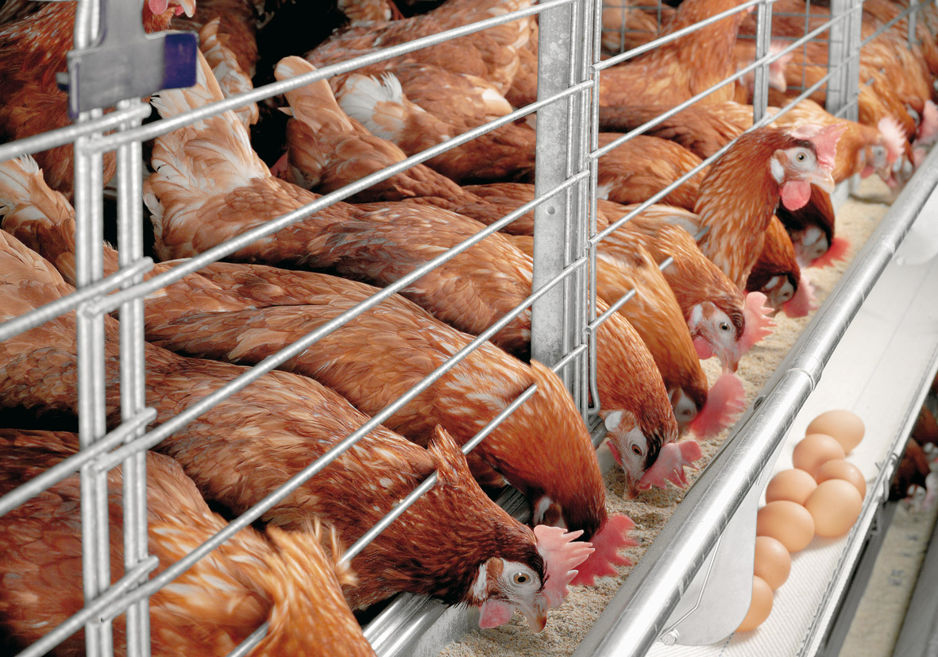
manger

Slide 21
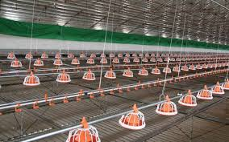

Slide 22
B-The utensils
a-Allocated (1,25)cm of the length of the utensils to each chicks through the three first weeks of chick old .
b-Allocated (2,5)cm of the length of the utensils to each
chick through the second three weeks of chick old .
c-Allocated (4)cm of the length of the utensils to each chick after (6)weeks of chick old
d-Allocated (2) utensils of (5)gallon to each (100)birds if
plastic utensils

Slide 23
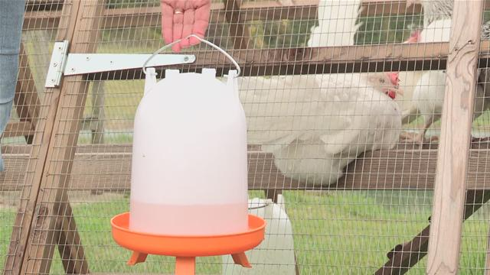
utensilis

Slide 24
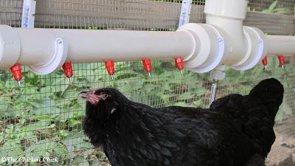

Slide 25
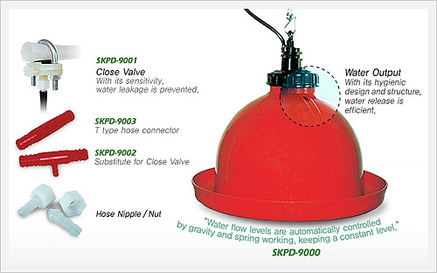

Slide 26
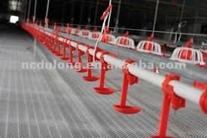

Slide 27
4-supplies a good area to chicks
Are (m)2 | Chicken type
15 | Egg chicken (Light type )
10 | Heavy type ))Meat chicken
12 | Dual purpose chicken

Slide 28
Lighting
The sense of sight is very sophisticated in poultry When talking about the lighting must differentiate between the severity of the luminescent and Light duration .
lighting intensity:- It is the intensity of light falling on the bird and is measured in units of watts . lighting duratino:- A time period in which the birds are exposed to the light of day and is measured in hours.

Slide 29
The increase in light chicken leads to:
1. The increase in cases of clicking or predation cannibalism and feather plucking molting.
2. chicks agitation and hyperactivity.
3. Retention as a result of the destruction of the egg impaction.
4. spawning an early age and have a small size.
. Non-laying hens ability to continue production of higher productivity for the full year and this leads to losses
economic. Significant

Slide 30
Lighting duration
Time (hour) /day | Chicken type
23 | Meat chicken
14 | Egg chickens (1day-14 weeks age )
9 | Egg chickens (15-20 weeks)
14-16 | Egg chickens (20—etc

